Slide 1

Practical Data Scientist Program
R
Python
Notes:
Explain about Miles

Slide 2
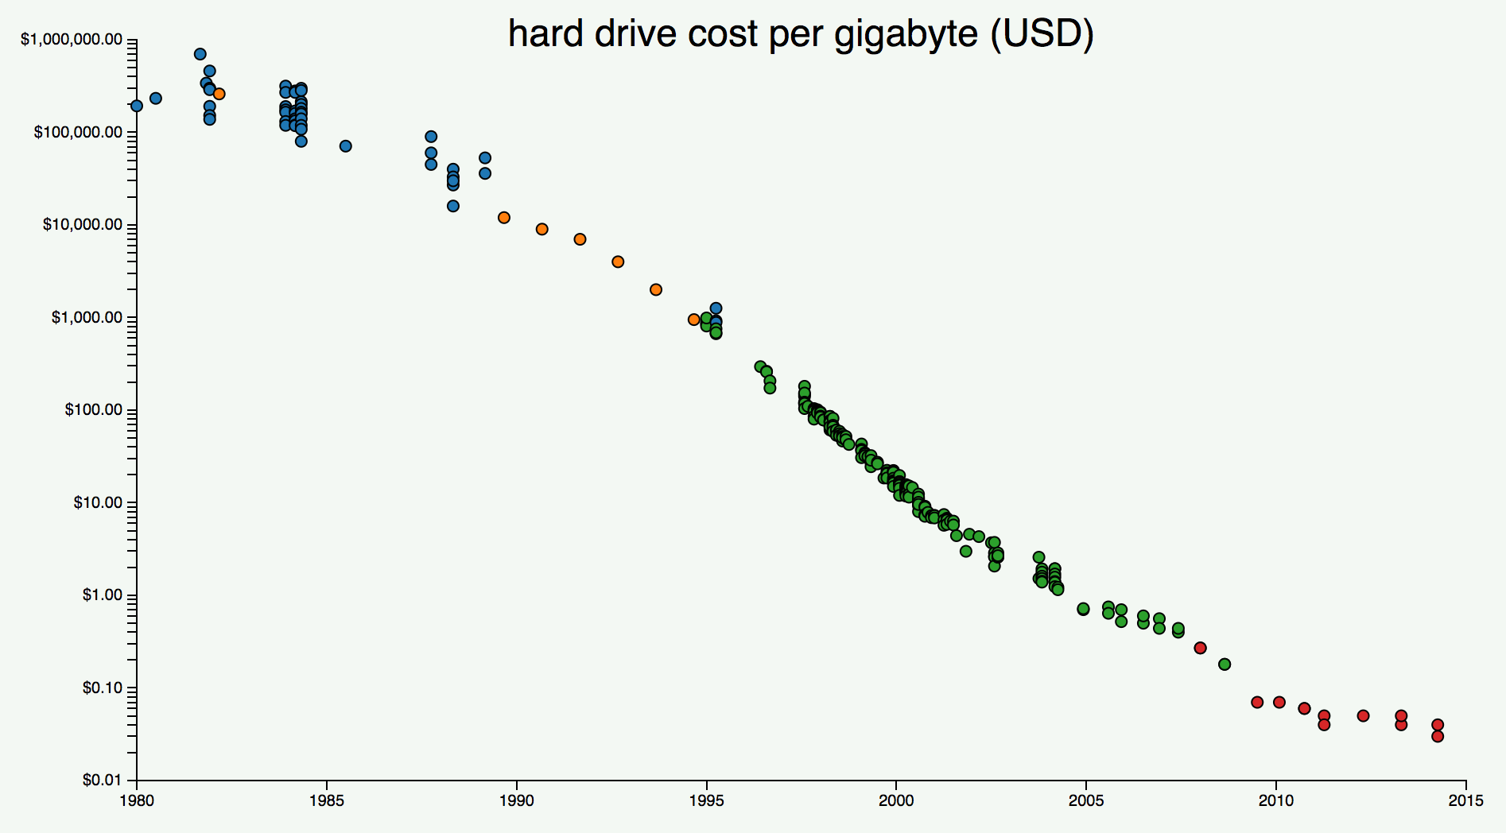
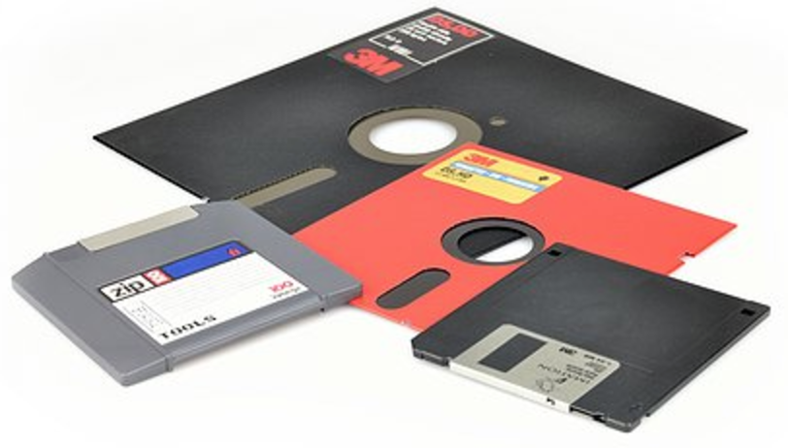


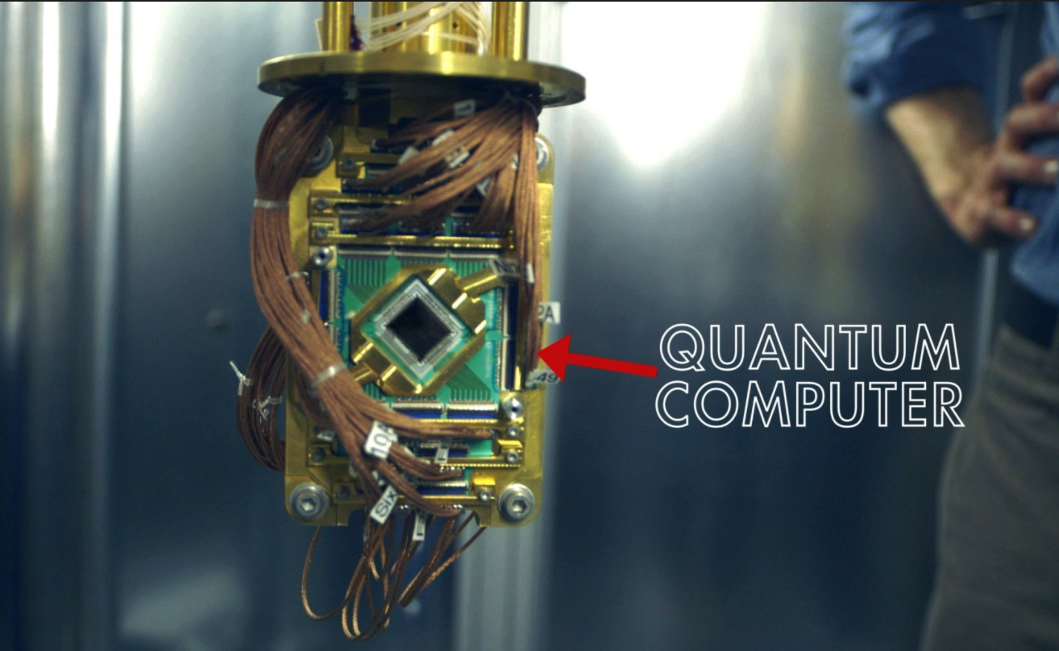
Storage capacity, size & cost

Slide 3
Interesting insights
Bombardier showcased its C Series jetliner that carries Pratt & Whitney’s Geared Turbo Fan (GTF) engine, which is fitted with 5,000 sensors that generate up to 10 GB of data per second. A single twin-engine aircraft with an average 12-hr. flight-time can produce up to 844 TB of data.
Saudi Aramco laid 650km of new pipelines across a mountain range of red sand dunes. How do they monitor that?
Using 100,000 sensors and data points on wells, pipelines, plants and terminals, it directs every drop of oil and cubic foot of gas that comes out of the kingdom
One study predicts that by 2020, 1.7 MB of data will be created every second for every person on earth.
The average number of AI projects for a business is expected to increase to 35 by 2022 from four this year, according to a Gartner Inc. survey of about 100 organizations of various sizes, many of them with annual revenue of $1 billion to $3 billion. The research and advisory firm also said the number of its clients requesting help in dealing with AI suppliers grew 57% between 2017 and 2018.
As per the report by NASSCOM and Blueocean, India is reigning big data analytics with a value of $1.2 billion placing it among the top 10 big data analytics markets in the world. They have also anticipated the growth becoming eight-fold by 2025, soaring to $16 billion. With this vision in mind, every sector is now looking forward to Data analytics for its evolution.

Slide 4
Interesting insights
Gartner forecasts that by 2022, "30% of CDOs will partner with their CFO to formally value the organization’s information assets for improved information management and benefits," and "90% of corporate strategies will explicitly mention information as a critical enterprise asset and analytics as an essential competency."
A recent report by PwC forecasts that AI will contribute as much as $15.7 trillion to the world economy by 2030—this number is a strong testament to its potential. A study by Accenture further estimates that AI will add $957 billion or 15% of current gross value added to India’s economy by 2035.
Andreessen’s startup Netscape took about a minute to raise $2.7 billion, which was jaw-dropping at the time for an initial public offering.
Source: https://engineering.stanford.edu/magazine/article/could-machine-learning-put-impoverished-communities-back-map

Slide 5
Interesting insights
Hotels in Singapore are testing facial recognition to speed hotel check-in. (Bloomberg)
AI and human analysts are working together to monitor the Nasdaq for suspicious activity. (MIT Technology Review)
OpenAI has released the text-generating AI system that experts said could be used for malicious purposes. (The Verge)
Intuit has updated QuickBooks with more AI to help small and midsize businesses avoid cash flow issues. (ZDNet)
The U.S. National Transportation Safety Board said the Uber self-driving test vehicle that hit and killed a woman in 2018 failed to properly identify her as a pedestrian. (BBC)
Nightfall, which provides an AI system for preventing sensitive data leaks,raised $20.3 million in funding. (VentureBeat)
Yandex, the Russian search and services company, is testing self-driving cargo delivery robots. (TechCrunch)
The way to get leaders to support AI projects is to focus on the technology’s potential to augment humans and drive ROI. (Becker’s Hospital Review)

Slide 6
Interesting insights
Using AI to spot early signs of wildfires. Artificial intelligence has been used to predict storm and earthquake damage and to identify locations likely to be hardest hit. Now an AI company in San Francisco called Chooch is working with state agencies, researchers and others to create a tool to scan satellite images to detect wildfires in their earliest stages, the Washington Post reports.
Coveo reaches unicorn status. Enterprise and data analytics software startup Coveo Solutions Inc. is the latest artificial-intelligence unicorn. It raised $227 million in new funding, bringing its valuation to more than $1 billion, reports WSJ’s Marc Vartabedian.
Mobileye, an automotive sensor company that Intel bought in 2017, is teaming up with Chinese electric car company Nio to develop driverless vehicles for consumers. (TechCrunch)
Ford Motor hired Scott Griffith, former Zipcar chairman and CEO, to head its driverless vehicle operations. (CNBC)
Booz Allen Hamilton is opening an app-store-like AI marketplace that will include pre-trained AI models that can handle specific tasks, such as recognizing buildings from aerial imagery. (Fortune)
The U.S. Postal Service is planning to use AI technology to help it process package data 10 times faster. (Reuters)

Slide 7
Interesting insights
Facebook detailed a new machine-learning algorithm that uses raw audio to enhance speech recognition. (VentureBeat)
Uber is looking for a new track near Pittsburgh to test autonomous vehicles. (Pittsburgh Post-Gazette)
Surgery, event planning, and fashion design are among the jobs robots can’t do yet. (PBS)
Neural Magic, a startup that developed a method to run machine learning models on commodity CPUs, raised $15 million in seed funding. (TechCrunch)
Untether AI, a chip startup, raised $29 million. (VentureBeat)
Nvidia said its new AI chips topped a series of benchmark tests. (Reuters)
Early adopters of health-care AI report seeing success in predicting readmissions and unnecessary emergency department visits. (FierceHealthcare)
Kohl’s is looking to use machine learning for digital media buying. (Ad Age)
Teradyne, a maker semiconductor test-equipment, is establishing itself as a robot powerhouse. (Barron’s)

Slide 8
Alarming – Upskill or Future looks bleak….

Slide 9
Project Management Methodology
https://360digitmg.com/2019/08/18/high-level-project-management-overview-data-science/
Notes:
Explain about Miles

Slide 10
Detailed Curriculum
Python & R programming
Convolution Neural Network
Pretrained models
Visualizing convnet filters
Visualizing hidden layers
Recurrent Neural Network
Bi-directional
Deep Bi-directional
CNN+RNN
Mathematical Foundations
Machine Learning Primer
Autoencoders & VAEs
Restricted Boltzmann Machines (RBM)
Deep Belief Networks (DBN)
Long Short Term Memory
Gated Recurrent Units
Deep Learning Primer
Generative Adversarial Networks (GANs)
Super Resolution GANs
Perceptron Algorithm
Speech recognition
Multilayer Perceptron (MLP) / ANN
Game Playing agents & Robotics
Board Games & Computer Games
Computer Vision
Deep Dream
Reinforcement Learning / Q-learning
Genetic Algorithm to Optimize Hyperparameters
Notes:
Explain about Miles

Slide 11
Data Science and
AI Applications
Notes:
Explain about Miles

Slide 12
Data Science and AI Applications
Heaven to hell: the history of deception
Pornography is awash with videos in which celebrity faces have been pasted onto the writhing, naked bodies of adult actors. Earlier this year Jordan Peele, an American comedian, used an artificial-intelligence face-swapping tool to create a clip of what appears to be Barack Obama calling his presidential successor “a total and complete dipshit”. These examples show the power of technology to bend reality.
Focus: the travel industry
“A freestyle broom in mince?” Forget the hype; most people after a three-star hotel in Belarus’s capital find it easier to type on a website, not talk to it. But travel firms have high hopes for artificial intelligence. People use more words speaking to an AI interface than when typing, so searches will become more nuanced. At some companies, chatbots already respond to the majority of customers’ questions. Optimists claim AI will soon know what sort of trip customers want before customers themselves do, and will then find the perfect marketing channel. Carnival, a cruise operator, has experimented with tagging passengers so it can track them on the ship, helping it deploy staff (and target offers from shops and bars). The future may be particularly bright for sourpusses. Already hotel guests can check in online, receive room-keys on smartphones and be served by automated butlers. Soon they might never need to interact with human staff.
Source: Economist

Slide 13
Data Science and AI Applications
“Do you tech…”: Harry weds Megan
​Love or loathe them, British royal weddings are global media events. As soon as Prince Harry announced his marriage to Meghan Markle, speculation began about who would attend. Sky News hopes to make it easier to see who’s who tomorrow by using machine learning. Guests entering Windsor Castle will be analysed and identified by Amazon’s Rekognition service. Viewers watching via an app will see celebrities automatically named when they appear, with details pulled from the cloud about what they do (if anything). However, facial-recognition software is still far from perfect. When used by British police to identify criminals at public events in 2016 and 2017, it was reportedly inaccurate 95% of the time. This time, the software’s designers have even practised using it on themselves wearing a variety of different hats, in the hope of reducing the likelihood of embarrassing machine mix-ups. Celebrity-spotters needn’t worry about artificial intelligence stealing their jobs just yet.
The middle way: Europe’s AI strategy
There are two global hotspots in the development of artificial intelligence: Silicon Valley and China. Today, the European Commission will lay out its plan to catch up, publishing a document outlining its long-term AI strategy. It casts Europe as a middle ground, with a stance somewhere between the state-backed firms of China and America’s data-rich tech outfits, such as Google. The plan emphasises digital rights and ethics—the commission promises an ethics charter next year, and a global push for co-operation on standards co-ordinated through bodies such as the UN and the OECD. It also commits to spending €110m ($134m) to set up repositories of data and algorithms available to smallish firms getting started in AI. In total, the commission will put forward €14bn in its next budget to support research and development in AI. Judiciously spent, that could go some way towards creating a third hotspot for the technology.
Source: Economist

Slide 14
Data Science and AI Applications
As good as a human: AI in diagnostics
Prostate cancer is the most common male cancer, with about 1.1m new diagnoses every year. Yet a little-known secret about the current screening for the disease is that it does not work. This month a British study of 400,000 men, the largest ever, found that screened and unscreened men had the same chance of dying from cancer. Now scientists are developing better tools. This week news emerged that Chinese scientists have created an artificial-intelligence system that can diagnose and identify cancerous prostate samples as accurately as a pathologist, as well as reliably classify the level of malignancy. Automating diagnostics is likely to increase the precision of diagnoses, as well as reducing costs. Prostate cancer is not the only beneficiary of such AI. Advances are being pursued in many other areas, including strokes and breast cancer. Both radiology and pathology are facing a long-needed technical revolution.
A new report warned that the unfettered rise of artificial intelligence could lead to new forms of cybercrime. The research, conducted by AI academics and civil-society organisations, said that as AI becomes more powerful, it will empower misdeeds including automated computer hacking, sophisticated fake news outbreaks and attacks on the physical world, perhaps by drones.
Source: Economist

Slide 15
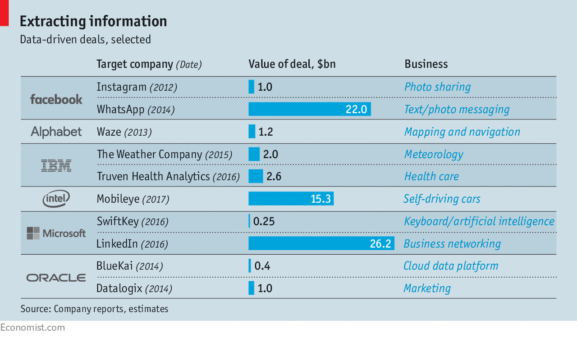
Data Science and AI Applications
Deeper minds: artificial intelligence
Human orchestras playing music composed by computers; machines learning in hours what took humans millennia; halls packed with thousands of people listening to computer-science talks in hushed reverence. All par for the course at this week’s Neural Information Processing conference, the premier artificial-intelligence summit. The conference revealed the increasing pace of development of AI, and of its spread into every conceivable industry. That is most evident in the development of hardware. Tesla, an electric-car maker, is working on its own chip to run AI algorithms, in partnership with AMD, a microprocessor manufacturer. Nvidia, another chipmaker, will start selling the “Titan V”, a $3,000 processor specially designed for training AI algorithms. The next generation experimental-fusion reactor built by TAE, an energy firm, will be explicitly designed to produce data to feed into AI that will optimise the nuclear reaction. The firm that will receive and process those data? None other than Google.
Source: Economist

Slide 16
Data Science and AI Applications
Artificial experts: detecting forgeries
​Art attribution has long relied on the eyes, and gut feeling, of experts who can recognise “invariant” characteristics, such as how an artist habitually depicts ears or hands. It gets even trickier when it comes to drawings and prints, where the lower value of the work makes technical analysis such as carbon dating and infrared imaging prohibitively expensive. But a study by America’s Rutgers university and the Atelier for Restoration and Research of Paintings in the Netherlands has found a way of detecting whether a drawing is forged by comparing single strokes. Using a form of artificial intelligence called a deep recurrent neural network, combined with a machine-learning algorithm, researchers analysed 300 drawings. The system identified the artist behind a single line 70-90% of the time, and spotted the forgery every time. The researchers plan to extend the technique to paintings with bold brushstrokes, such as Impressionist art. Forgers be warned: the robots are coming.
Cloud computing: heading into the fog
The average internet user knows that much computing is now done in the “cloud”—in data centres operated by internet giants. But some computing is now expected to move back to the “edge”, because of artificial intelligence. Algorithms for AI services, such as those powering autonomous cars, will be “trained” in the cloud (in that case, by showing them lots of traffic footage, among other things). But the “inference” (the calculations needed for automated driving) will happen in devices at the edge (powerful computers in the vehicle). Sending all the data collected by a car to the cloud and then waiting for driving instructions to come back would simply take too long to avoid hitting that cyclist running a red light. Yet this two-tier system won’t spell the “end of cloud computing” as some suggest. Clouds will continue to exist, and will even grow—but they will become part of an all-engulfing “computing fog”.
Source: Economist

Slide 17
Data Science and AI Applications
IBM tests AI for flagging disgruntled insiders. IBM’s lab in Australia is trying to develop an AI tool to analyze employee behavior and help companies identify potential threats, CSO reports. The tool examines words and tones used in email, along with activities such as file downloads. It also scans social posts to gauge a worker’s state of mind. It produce a risk score after analyzing these and other details.
Hong Kong law enforcement has AI facial-recognition software. Police in Hong Kong already have access to artificial intelligence software that can match faces from video footage to police databases, Bloomberg reports. It’s unclear if the technology, developed by video-analytics company iOmniscient, is being used against the city's pro-democracy protests, Bloomberg writes, citing unnamed sources.
SCB Asset Management to use AI to identify investments. SCB Asset Management Co. plans to offer more equity funds using AI to identify investments as it looks to gain new customers and retain existing ones, Bloomberg reports. AI, data analytics and program trading will allow SCB Asset, Thailand’s biggest mutual-fund firm, to soon start selling its own funds to invest in overseas equities, according to Narongsak Plodmechai, the chief executive of SCB Asset, which oversees about 1.5 trillion baht ($50 billion) of assets. AI technology can let funds pivot in and out of assets without human bias and without approval delays, according to the report.
Developing successful government AI strategies. The U.S. has budgeted almost $1 billion for artificial-intelligence research, excluding defense, for the fiscal year ending in September 2020.
Source: WSJ
Notes:
Explain about Miles

Slide 18
Data Science and AI Applications
Organizations see risk in ‘shadow AI.’ By 2022, Gartner says 30% of organizations using AI for decision-making will come up against “shadow AI” as the biggest risk to effective and ethical decisions, reports the WSJ’s Sara Castellanos. Shadow AI refers to data outside the ownership of the IT department that is used to build AI models.
Border patrol seeking information on facial recognition for body cams. The U.S. Customs and Border Protection last week put out a request for information on body cameras, cloud storage and video management software that could assist agents checking for contraband and for immigrants illegally entering the country, reports Reuters.
Fujitsu develops new emotion AI technique. Fujitsu’s laboratories develop AI-based technology that can pick up slight changes in a person's facial expressions, such as nervousness or confusion, reports ZDNet. While other emotion AI tools can recognize expressions, they are limited to eight “core” states: anger, contempt, fear, disgust, happiness, sadness, surprise or neutral, according to the report.
Google shows off AI prowess with smartphone. Google’s Pixel 4 might be the most advanced phone you can buy, says the WSJ’s Joanna Stern in a review of the device. Artificial-intelligence software allows for stunning nighttime photos, better and faster communication with Google Assistant and the ability to process speech-to-text in real time without an internet connection.
Media-monitoring startup raises $25 million. London-based Signal AI will use the money raised in its Series C round to develop software that scours news sources and other public data to look for trends and risks,TechCrunch reports.
Source: WSJ
Notes:
Explain about Miles

Slide 19
Data Science and AI Applications
Indiana University to build AI center. Fred Luddy, an Indiana University alumnus and the founder of ServiceNow, a Silicon Valley-based IT company, donated $60 million to IU to build the Luddy Center for Artificial Intelligence, according to a report on IndyStar.com.
BCG Key findings:
9 of 10 business leaders believe AI can help a company generate revenue, reduce costs and develop new products or services
9 of 10 executives said they made some investment in the technology; of those, fewer than 2 in 5 report any business gain from their AI efforts in the past three years
Many executives believe they risk being put at a competitive disadvantage if a rival figures out how to exploit AI before they do
An increasing number of school districts are using facial recognition. Eight public school systems have deployed facial recognition systems, according to Wired, which said there are probably more. School administrators say the technology is a tool that can spur responses to, or even prevent, shootings and other incidents.
1 million
The number of miles Yandex’s driverless vehicles have traveled on public roads, reports VentureBeat.
Source: https://venturebeat.com/2019/10/17/yandexs-self-driving-cars-have-driven-1-million-miles/
Source: WSJ
Notes:
Explain about Miles

Slide 20
Data Science and AI Applications
AI funding deal. Invoca Inc., a provider of AI-powered software that lets companies analyze customer phone calls, said it raised $41 million in new equity financing and secured a $15 million line of credit, reports WSJ Pro’s Jared Council.
64%
The percentage of 8,370 workers, managers and human-resource execs responding to an Oracle and Future Workplace survey who say they would trust a robot more than their manager, according to ZDNet.
South Korea invests in transportation. South Korea is looking to speed the adoption of self-driving, electric and flying cars in a move to stimulate its economy, reports Bloomberg. The country’s president, Moon Jae-in, said Korean businesses will invest 60 trillion South Korean won ($50 billion) into transportation in the next decade while the government will put up KRW2.2 trillion to help create related technology and infrastructure, according to the report.
Healx, which uses AI to discover new drug treatments for rare diseases, raised $56 million in a Series B funding round. The financing was led by Atomico with participation from Intel Capital, Balderton Capital, Global Brain, Btov Partners, Amadeus Capital Partners,and Cambridge Innovation Capital’s Jonathan Milner. (VentureBeat)
Source: WSJ
Notes:
Explain about Miles

Slide 21
Data Science and AI Applications
Demand for these workers is growing as companies world-wide seek an edge over competitors by using technology such as cloud computing, data analytics and artificial intelligence. Sought-after IT workers, such as developers and engineers with experience in AI, who take new jobs this year are fetching average annual salaries of $200,000, up from $150,000 a year ago, according to staffing firm Mondo, a subsidiary of Chicago-based Addison Group LLC.
https://www.wsj.com/articles/americas-got-talent-just-not-enough-in-it-11571168626?mod=djemAIPro
Manufacturers are expected to use nearly four million robots world-wide by 2022. Singapore currently has the highest density of industrial robots, but their use is growing fastest in China.
Chatbot developer raises $8.4 million. Startup Xor, which is developing a chatbot platform for recruiters and job seekers, raised $8.4 million in a seed round, reports VentureBeat. The funding was led by SignalFire with participation from Gurtin Ventures and Twin VC.
Source: WSJ
Notes:
Explain about Miles

Slide 22
Data Science and AI Applications
Hockey makes big data power play. This season, the National Hockey League is introducing a puck- and player-tracking system that promises to unleash a wealth of data about player movement and execution. The Wall Street Journal's Laine Higgins examines the system developed by SMT, the sports technology company behind football broadcasts’ glowing yellow first-down line.
Self-driving truck startup Einride raises $25 million. Autonomous electric delivery truck startup Einride raised $25 million in a Series A investment round that it said would help expand the Sweden-based business into the U.S., the Journal reports.
Clari raises $60 million in new funding. Clari Inc., a provider of an artificial-intelligence-based sales and marketing platform, said Thursday it raised an additional $60 million in venture-capital funding to bring its total to $135 million, WSJ Pro reports.
AI funding set to hit record. Artificial intelligence startups are on a pace to set a new funding record, reports VentureBeat. Through the first nine months of the year, 965 AI-related companies in the U.S. raised $13.5 billion in venture funding, according to third-quarter 2019 data from the National Venture Capital Association.
Source: WSJ
Notes:
Explain about Miles

Slide 23
Data Science and AI Applications
California bans police use of facial recognition in body cams.California Gov. Gavin Newsom signed a bill prohibiting police in the state from using facial recognition technology in body cameras, reports the San Francisco Chronicle. The law will take effect January 1. No police departments in the state currently use the technology, according to the California Peace Officers’ Association, although some have looked into it, according to the report.
Facial recognition deployed at New York's JFK. Lufthansa has deployed a biometric self-boarding process, which uses facial recognition, at a gate in John F. Kennedy International Airport’s Terminal 1, reports the New York Post. Officials said Air France, Japan Airlines andNorwegian Airlines are expected to also implement the technology, according to the report. And last year JetBlue installed a biometric self-boarding gate at JFK’s Terminal 5 for travelers heading to certain international destinations
Taste trends. McCormick, Conagra Brands and PepsiCo are among the food giants using AI to cook up new flavors and foods—such as bourbon pork-tenderloin seasoning and pudding flavors meant to call to mind unicorns.
Financial firms using AI to spot fraud. Financial firms are working to identify potential fraud by analyzing how customers hold their phones, how fast they type and other information about mobile interactions—and the strategy is yielding results, reports WSJ Pro Cybersecurity
Source: WSJ
Notes:
Explain about Miles

Slide 24
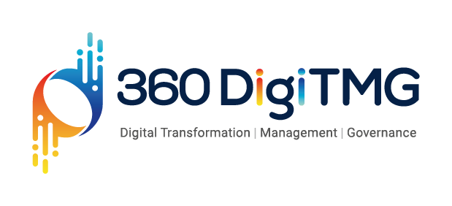

www.360digitmg.com
info@360digitmg.com

